Slide 1
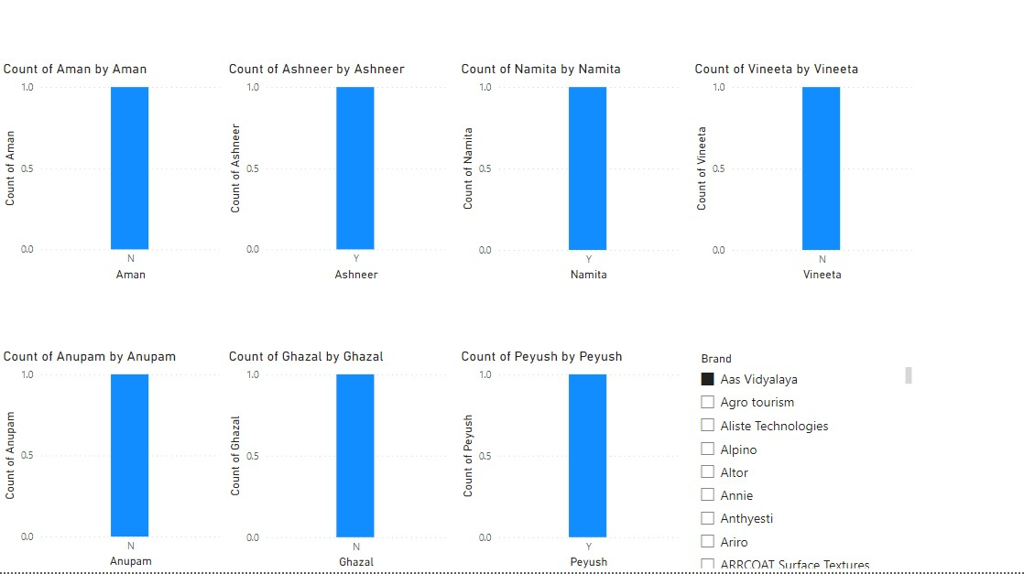

Slide 2
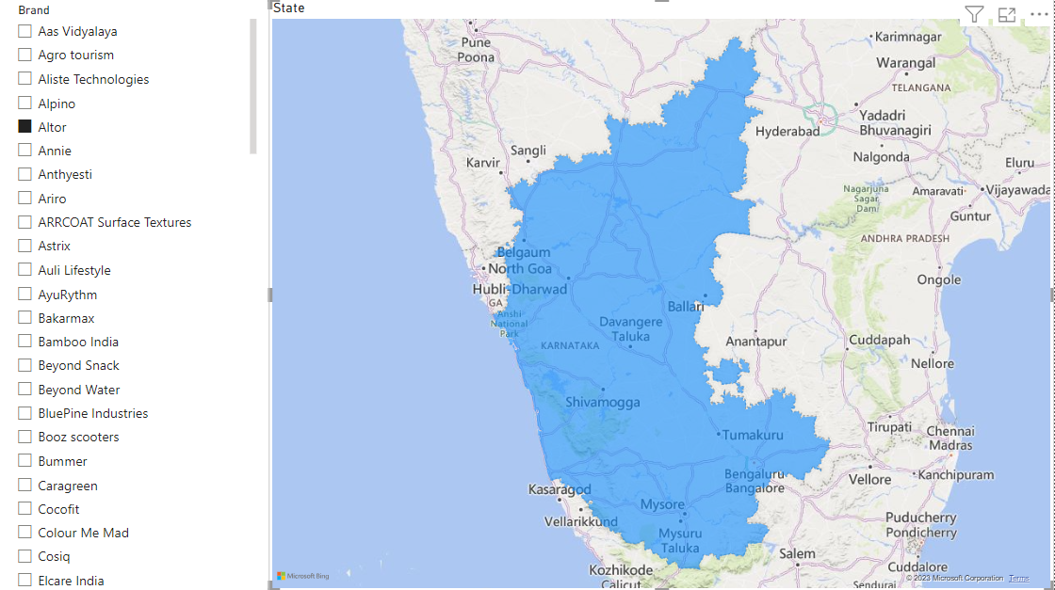

Slide 3
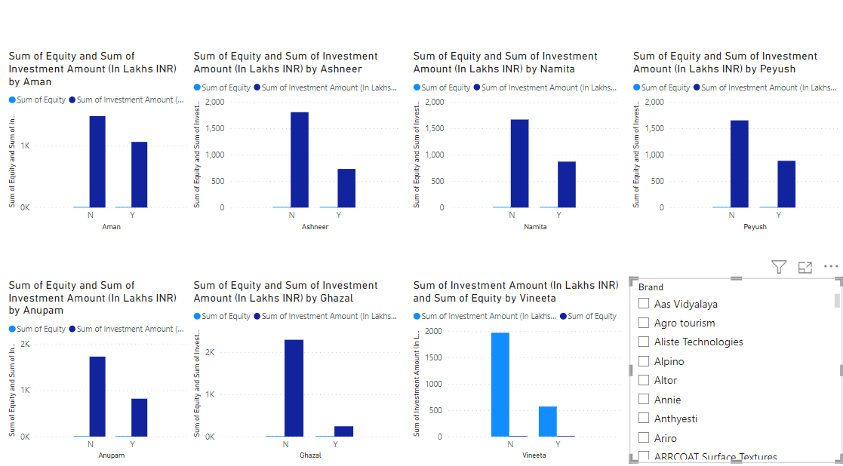

Slide 4
DATA STORY TELLING
The provided dataset appears to contain columns related to various attributes such as episode number, brand, investment amount, debt, equity, and the names of individuals (Anupam, Ashneer, Namita, Aman, Peyush, Vineeta, and Ghazal). It also includes columns indicating the season and state.
To create a data story from this dataset, we can analyze the relationships and patterns among these columns.

Slide 5
Let's explore some potential data insights and storytelling angles based on the available columns:
Episode Number and Brand: We can analyze how the episode number relates to different brands. This analysis could reveal trends in brand promotion and marketing strategies over time.
Investment Amount and Debt: By examining the investment amount and debt columns, we can identify the financial aspects of each episode. We can compare investments and debts across episodes or brands to understand patterns in financial decisions and evaluate the impact on the show's success.
Equity Distribution: The equity column, represented as a percentage, can provide insights into the distribution of ownership among individuals or entities. Analyzing equity distribution across different episodes or brands may reveal interesting ownership patterns or partnerships.

Slide 6
4.Individual Contributions: Analyzing the columns related to individuals (Anupam, Ashneer, Namita, Aman, Peyush, Vineeta, and Ghazal) can help understand their involvement in the show. We can explore their roles, contributions, or affiliations and see if any trends or patterns emerge.
5.Season and State: By examining the season and state columns, we can analyze how the show's performance varies across different seasons and regions. This analysis can provide insights into the show's popularity in specific areas and help identify regional trends or preferences.
6.Investment vs. Equity: Comparing the investment amount with the equity distribution can provide insights into the financial structure of the show. We can analyze if there is a correlation between investments made and the corresponding equity distribution among individuals or entities.
By combining these insights, we can craft a data story that highlights the financial dynamics, brand strategies, individual contributions, regional performance, and other interesting patterns within the dataset. The data story can help stakeholders gain a comprehensive understanding of the show's financial aspects, its success factors, and potential areas for improvement.

